Slide 1
UI Design and Prototype
Mobile Computing
GN341

Slide 2
Agenda
INTRODUCTION 3
Screens 4
Mockup 21
Prototype 23

Slide 3
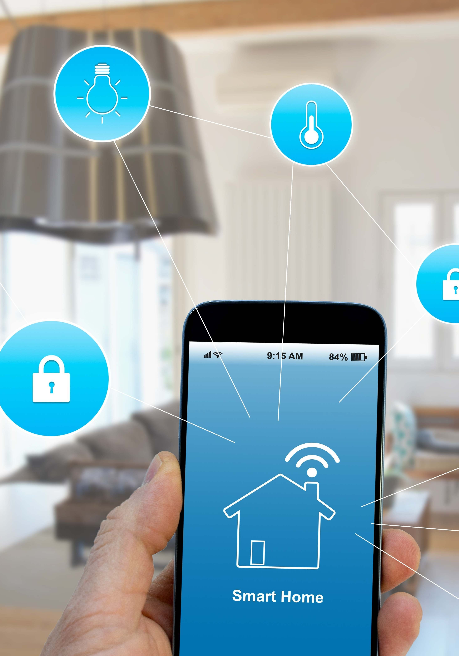
Introduction
Hello and welcome to BLYNKAWY! Our platform simplifies managing your home environment by integrating smart technology into everyday life. With our user-friendly interface, controlling your smart devices has never been easier. We're excited to announce that we have a simulation prototype available for you to explore the features and functionalities of our application. Click here to access the simulation and experience the convenience and efficiency of the application.

Slide 4
Screens

Slide 5
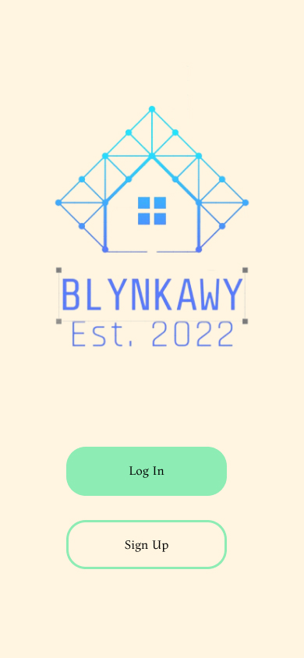
Welcome Page

Slide 6
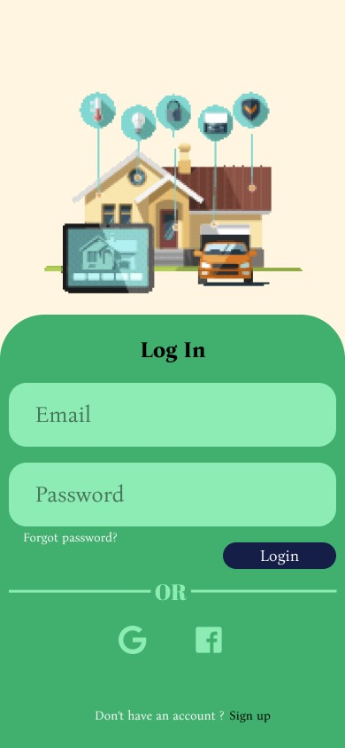
Login Screen

Slide 7
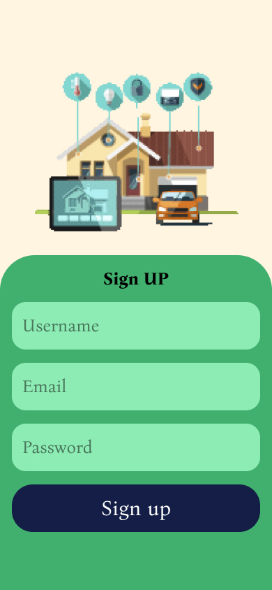
Sign up Screen

Slide 8
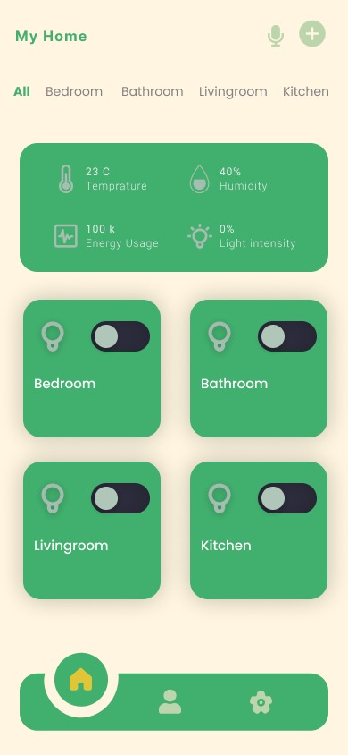
Home Screen

Slide 9
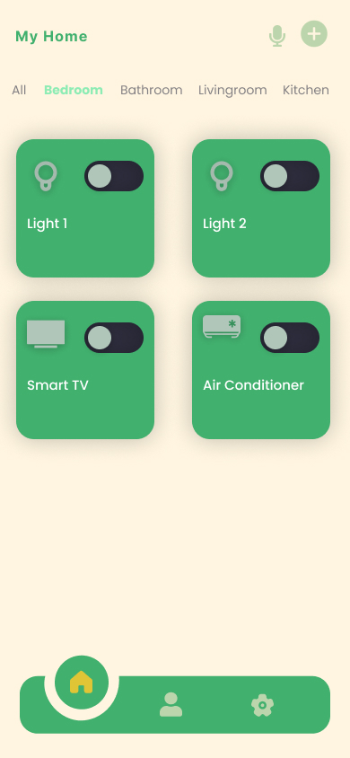
Bedroom Screen

Slide 10
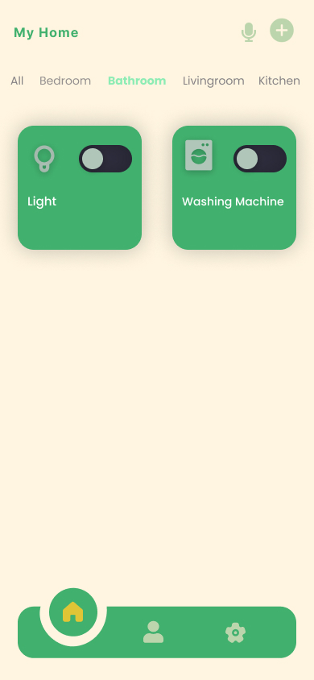
Bathroom Screen

Slide 11
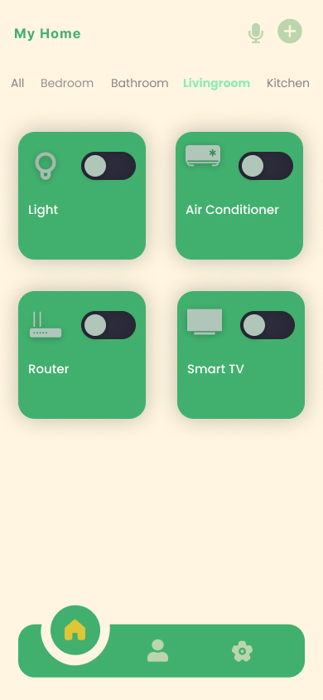
Livingroom Screen

Slide 12
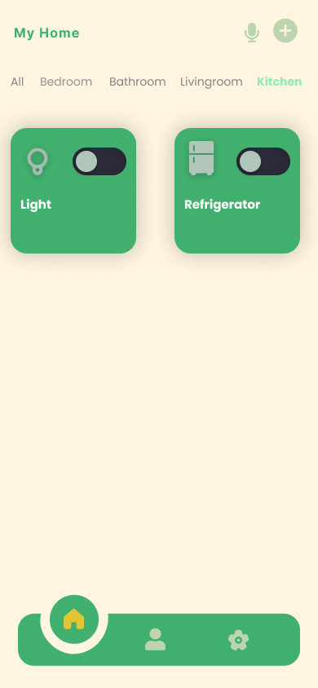
Kitchen Screen

Slide 13
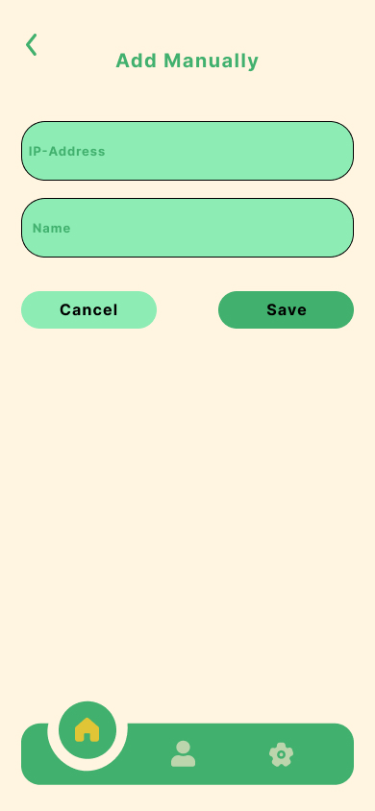
Add Manually Screen

Slide 14
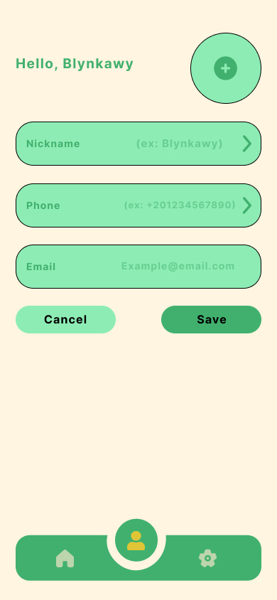
Profile Screen

Slide 15
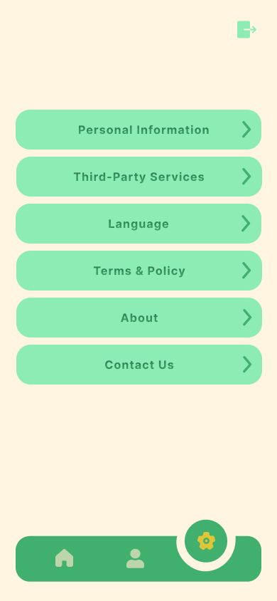
Settings Screen

Slide 16
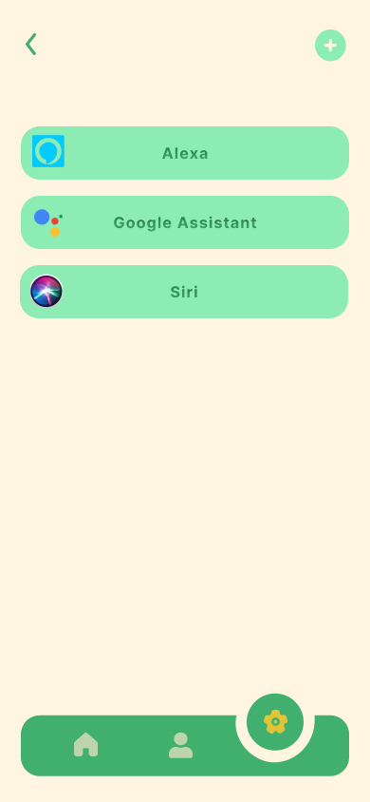
Third-Party Services Screen

Slide 17
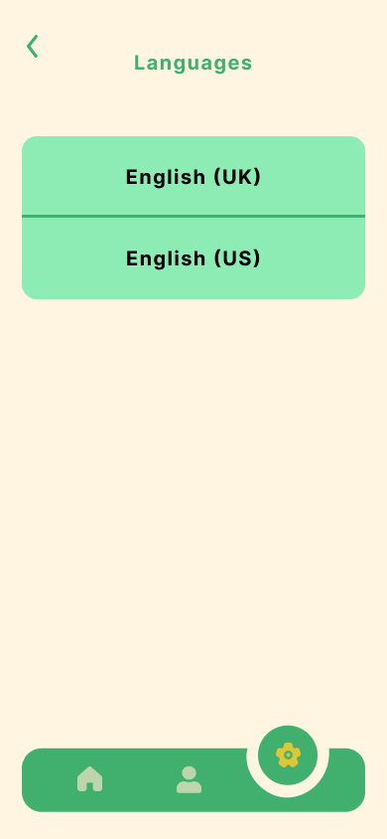
Language Screen

Slide 18
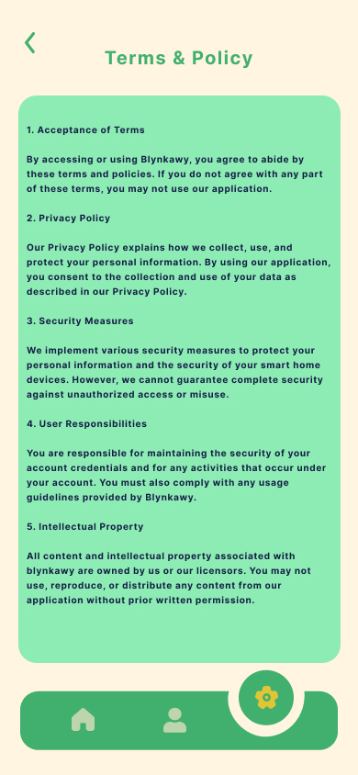
Terms & Policy Screen

Slide 19
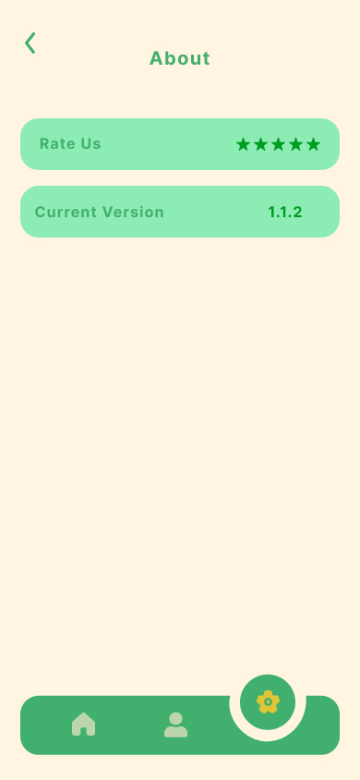
About Screen

Slide 20
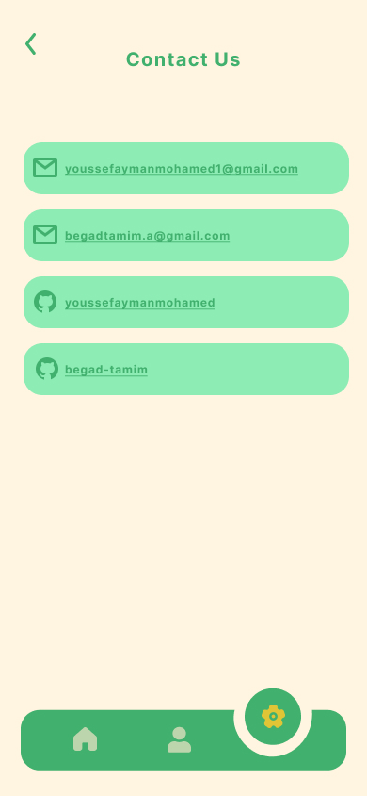
Contact Us Screen

Slide 21
Mockup

Slide 22
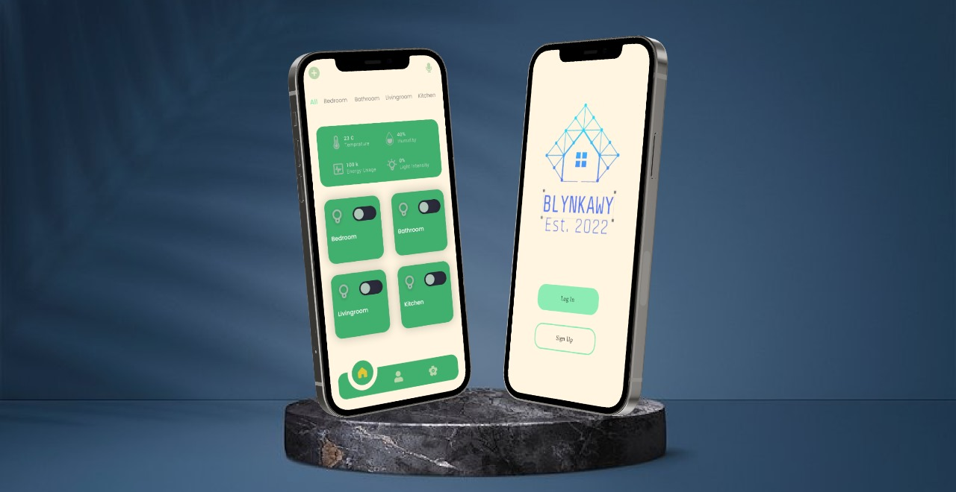

Slide 23
Prototype

Slide 24
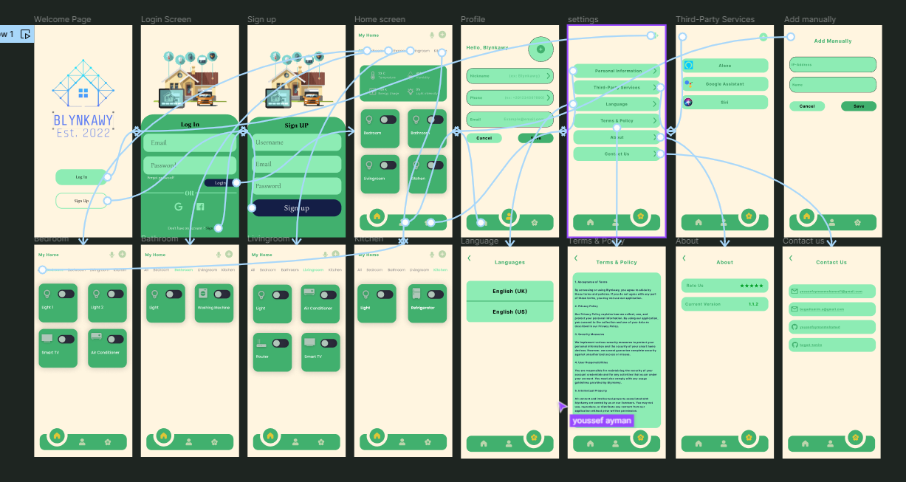

Slide 25
Thank YOU
Done by:
Begad Tamim – 211002177
Youssef Ayman - 211000348

